Slide 1
Using Machine Learning to Detect Falls In Real Time
By Danylo Krywyj, Reece Wareham and Fuhad Owolabi

Slide 2

Who is the Client?
Emergence robotics
Emergence Robotics facilitates robots within a healthcare environment, they have comprised a collaborative network involving the University of Nottingham, Sheffield, Heriot-Watt, Sheffield Hallam, and Hertfordshire
Aims of the collaborative network
The network Aims to establish a healthcare robotics community. This initiative seeks to unite researchers, health and social care professionals, service users, regulators, and policymakers, enhancing the deployment of robots to assist people with frailty in community settings.
What have we been tasked with?
We've been tasked with compiling a dataset and researching how machine learning models can be used to detect falls in real time, specifically in old adults.

Slide 3

What is the Project?
Detecting falls in real time is very important in the healthcare field as falls are the leading cause of injury-related death among older adults and those with mobility issues and are a major cause of hospitalisation and long-term care. Therefore, detecting when and how a person falls is critical in helping decrease response times and helping prevent future falls.
The goal of this project is to use machine learning algorithms to detect a person falling from video footage. In this project, we will be mainly focusing on detecting people falling forward due to it being the most common type of fall among older adults. A secondary goal of the project is to create a large suitable dataset comprising of many videos of people falling for future projects as currently the amount of data in this field is very limited.

Slide 4
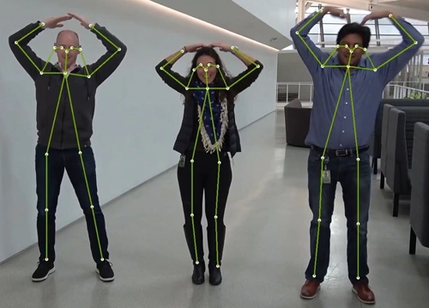
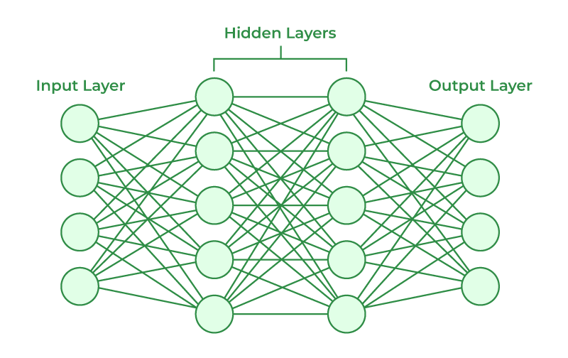
Proposed Solution
Our proposed solution for this project is to use a machine learning algorithm to detect falls from video footage. To do this, we will:
Extract skeleton model data from video footage
Annotate the data as either fall or no fall using CVAT
Train a machine learning algorithm to detect falls
The type of models we will be experimenting with in this project are:
Artificial neural networks
Support vector machines

Slide 5
Main Challenges
There have been many challenges so far during this project that we needed to overcome. Some of these are as follows:
Creating a suitable dataset from other datasets and own data
Researching and learning to use skeleton model pose detection tools
Learning how to annotate videos with labels

Slide 6


New Learnings from Project Development
There are a few skills and learnings each of us have learnt during the development of this project so far:
Learning how to collaborate in a small group
Working with a real client
Using project management tools (Trello)

Slide 7
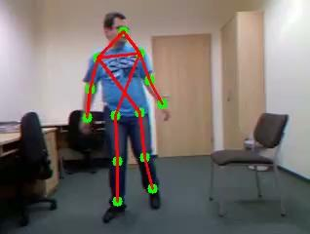
Skeleton Model Detection Video Demonstration

Slide 8

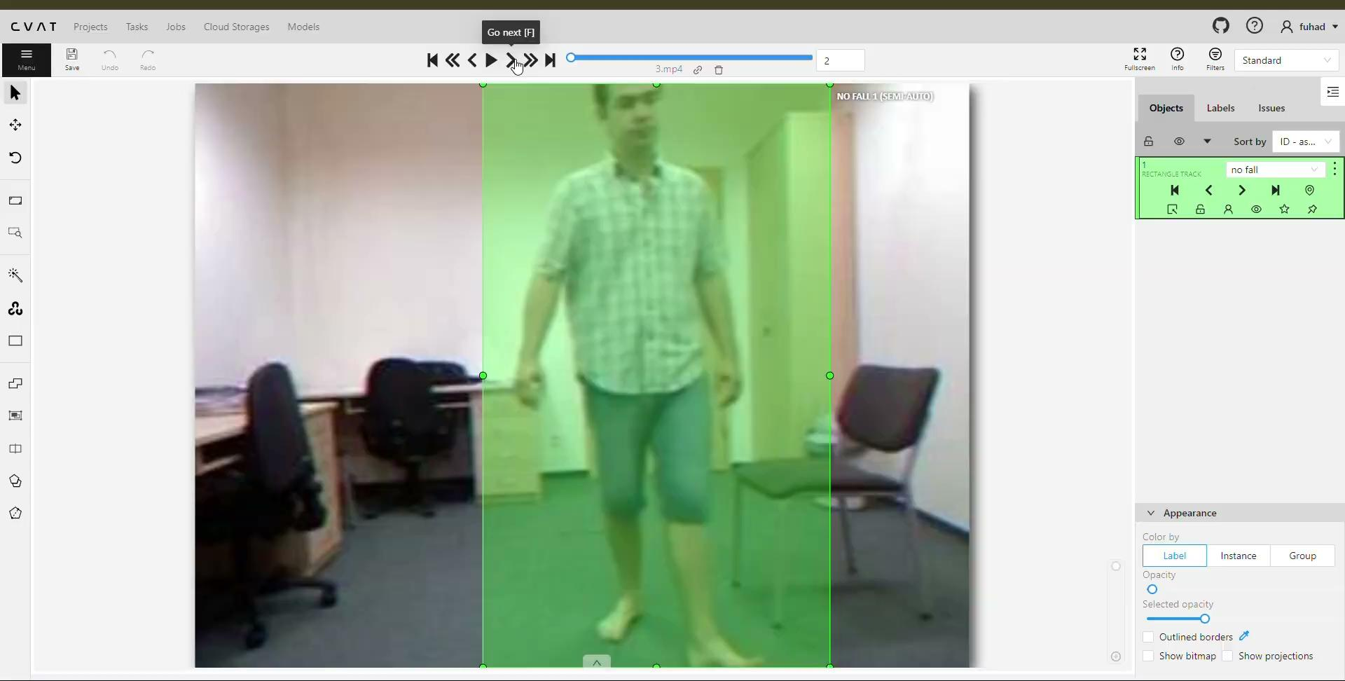
Computer Vision Annotation Tool (CVAT) Video Demonstration

Slide 9
Q/A

Slide 10
Thank You For Listening!

